Slide 1
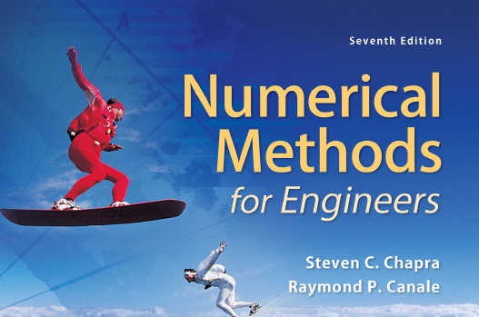
Least square Curve Fitting
Ch-17

Slide 2
Linear model
The dependence of one variable over the other is called Linear and the equation of such dependence is called linear model
Table 14.2 (on next slide) displays data on age and price for a sample of cars of a particular make and model. We refer to the car as the Orion, but the data, obtained from the Asian Import edition of the Auto Trader magazine, is for a real car. Ages are in years; prices are in hundreds of dollars, rounded to the nearest hundred dollars

Slide 3
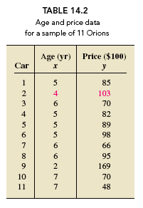

Slide 4
Plotting the data in a scatterplot helps us visualize any apparent relationship between age and price. Generally speaking, a scatterplot (or scatter diagram) is a graph of data from two quantitative variables of a population. To construct a scatterplot, we use a horizontal axis for the observations of one variable and a vertical axis for the observations of the other. Each pair of observations is then plotted as a point. Figure 14.7 (next slide) shows a scatterplot for the age–price data in Table 14.2.

Slide 5

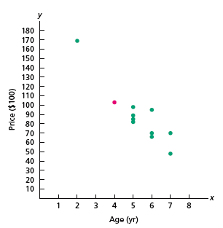

Slide 6
Because we could draw many different lines through the cluster of data points, we need a method to choose the “best” line. The method, called the least-squares criterion, is based on an analysis of the errors made in using a line to fit the data points.

Slide 7
Examples of Other Scatterplots
0
0
Y
Y
Y
0
0
X
0
X
X
Y
Y
Y
X
X
X

Slide 8
Simple Linear Model
The population simple linear model:
Y= β₀ + β₁ X + ε
where
Y is the dependent variable, the variable we wish to explain or predict
X is the independent variable, also called the predictor variable
ε is the error term, the only random component in the model, and thus, the only source of randomness in Y.
β₀ is the intercept of the systematic component of the Linear relationship.
β₁ is the slope of the systematic component.

Slide 9
Picturing the Simple Linear Model
Y
Linear Plot
E[Y]=β₀ + β₁ X
Y_{i}
{
}
}
Error: ε_{i}
β₁ = Slope
1
β₀ = Intercept
X
X_{i}

Slide 10
Assumptions of Linear Model
The relationship between X and Y is a straight-line relationship.
The values of the independent variable X are assumed fixed (not random); the only randomness in the values of Y comes from the error term ε_{i}.
The variance of Y at every value of X is the same (homogeneity of variances)
The errors ε_{i} are normally distributed with mean 0 and variance σ². The errors are uncorrelated (not related) in successive observations. That is: ε~ N(0,σ²)

Slide 11
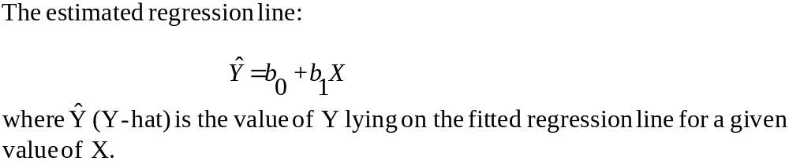
The Method of Least Squares
Estimation of a simple linear relationship involves finding estimated or predicted values of the intercept and slope of the linear line.
The estimated linear Linear
Y = b₀ + b₁X + e
where b₀ estimates the intercept of the population Linear line, β₀ ; b₁ estimates the slope of the population Linear line, β₁; and e stands for the observed errors - the residuals from fitting the estimated Linear line b₀ + b₁X to a set of n points.

Slide 12
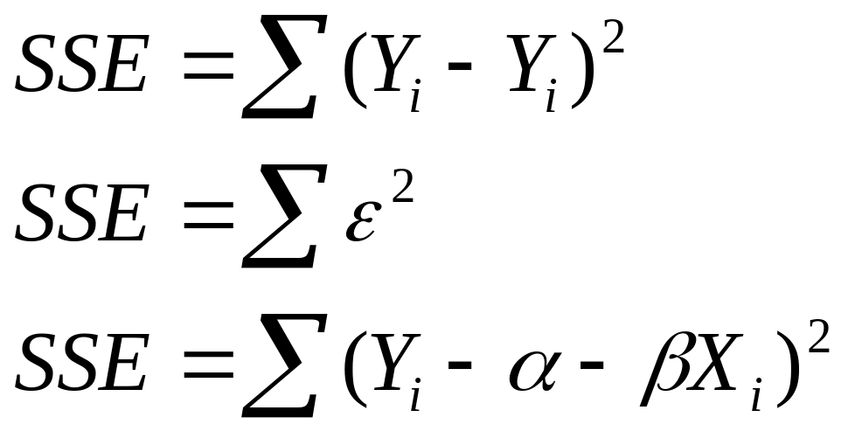
Estimating the intercept and slope: least squares estimation
Sum of deviation between observed and estimated values of dependent variable should be minimum
Or
Error sum of square should be minimum

Slide 13
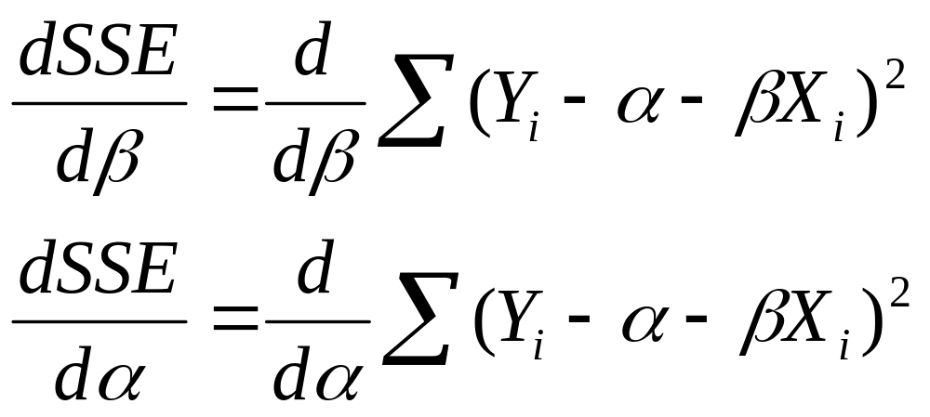
Estimating the intercept and slope: least squares estimation
Sum of deviation between observed and estimated values of dependent variable should be minimum
Or
Error sum of square should be minimum

Slide 14
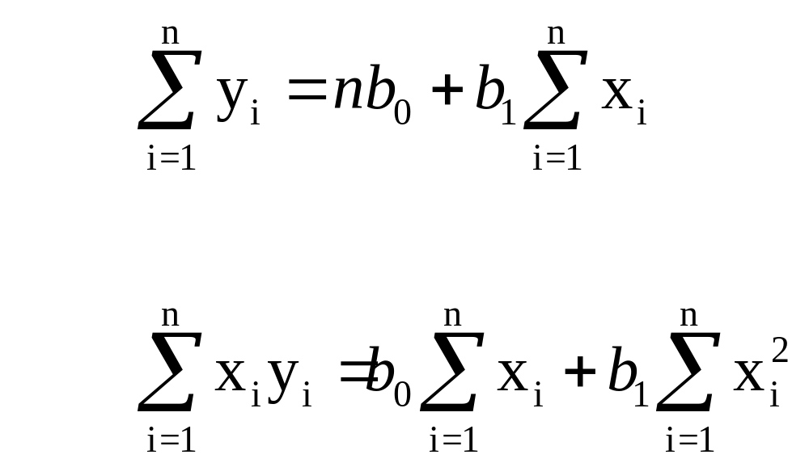
Normal Equations

Slide 15
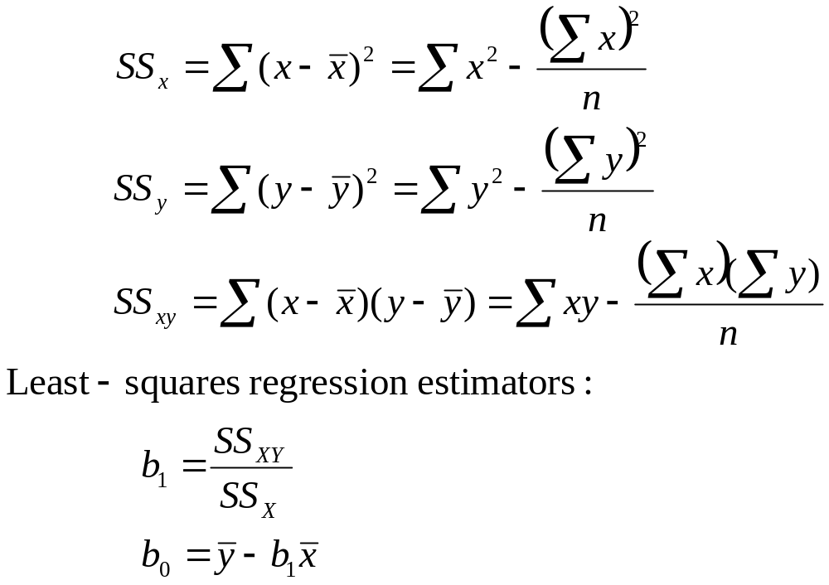
Sum of squares and cross product

Slide 16
Age and Price of Orions In the first two columns of Table 14.5, we repeat our data on age and price for a sample of 11 Orions.
a. Determine the Linear equation for the data.
b. Graph the Linear equation and the data points.
c. Describe the apparent relationship between age and price of Orions.
d. Interpret the slope of the Linear line in terms of prices for Orions.
e. Use the Linear equation to predict the price of a 3-year-old Orion and a 4-year-old Orion.

Slide 17
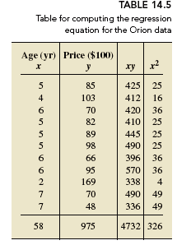

Slide 18
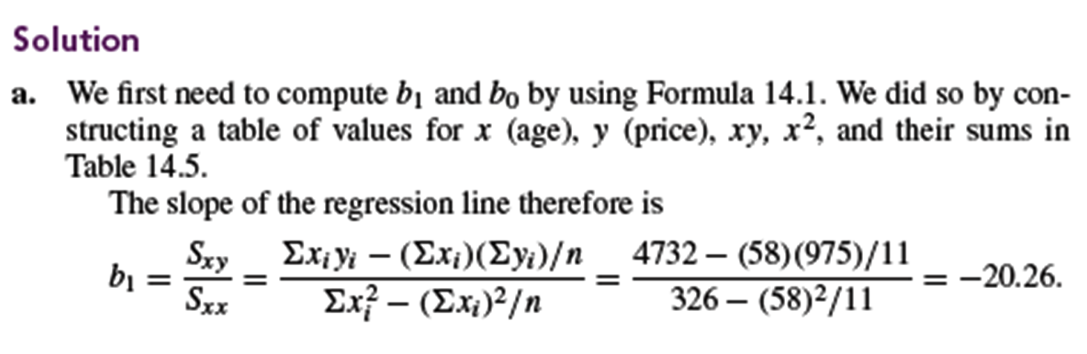

Slide 19
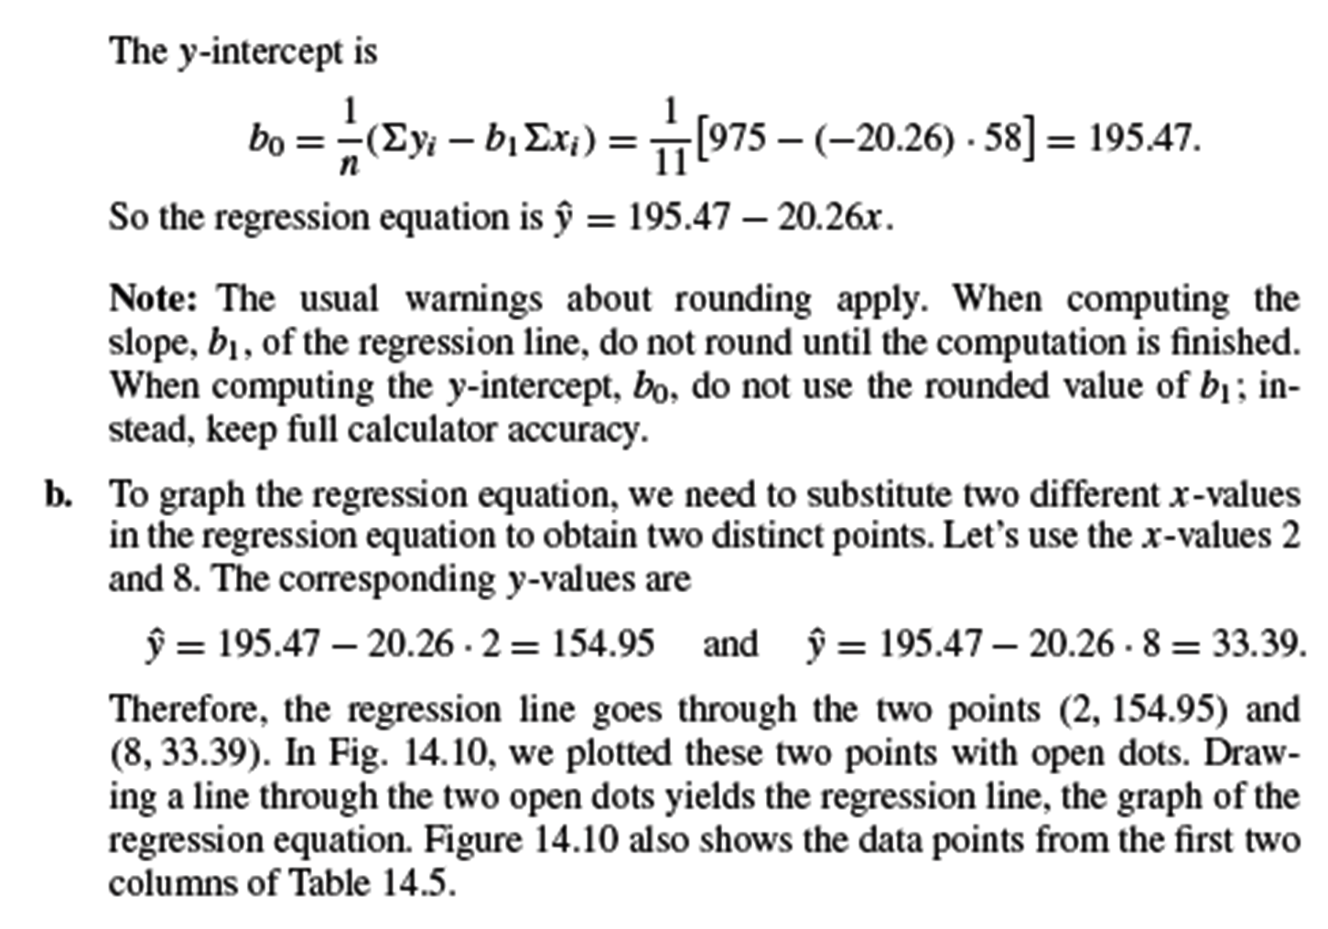

Slide 20
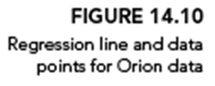
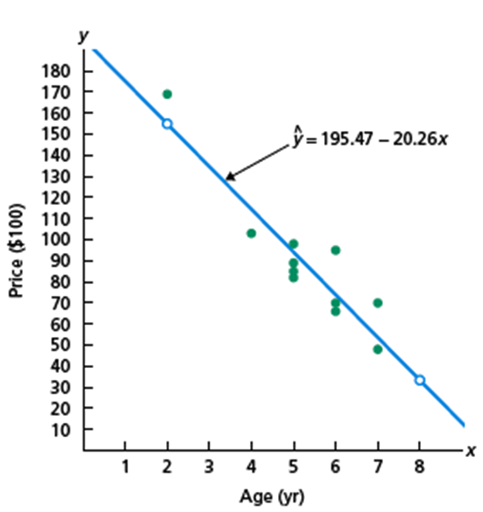

Slide 21
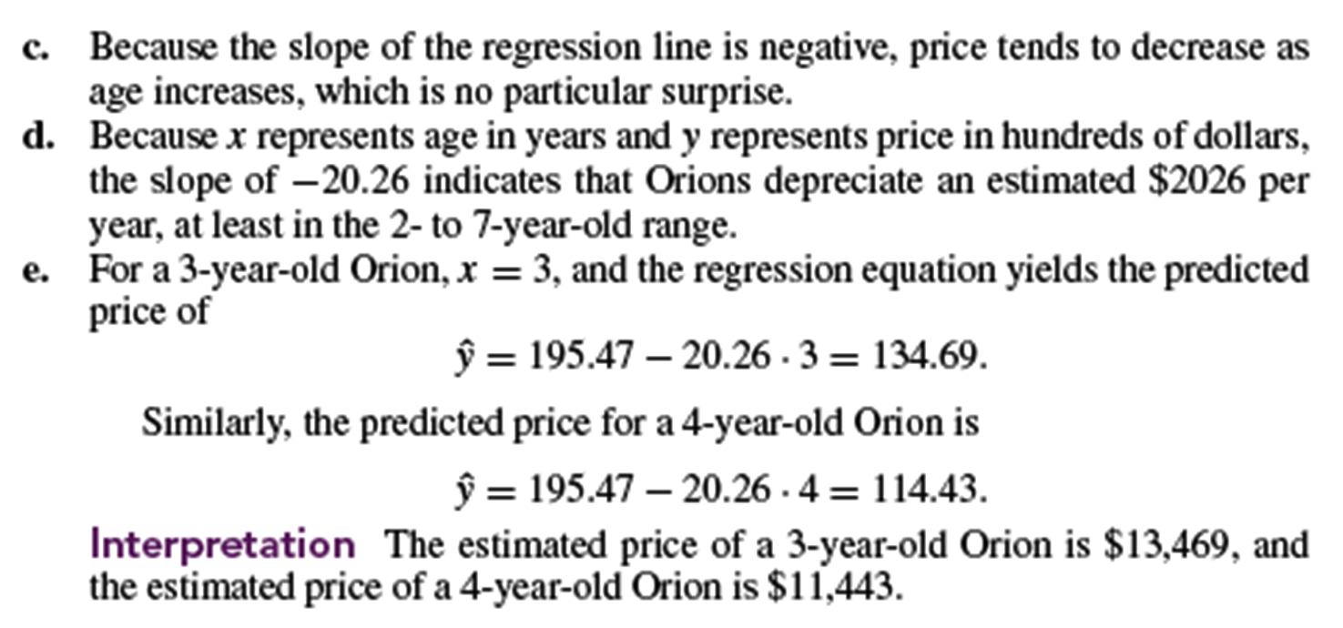

Slide 22
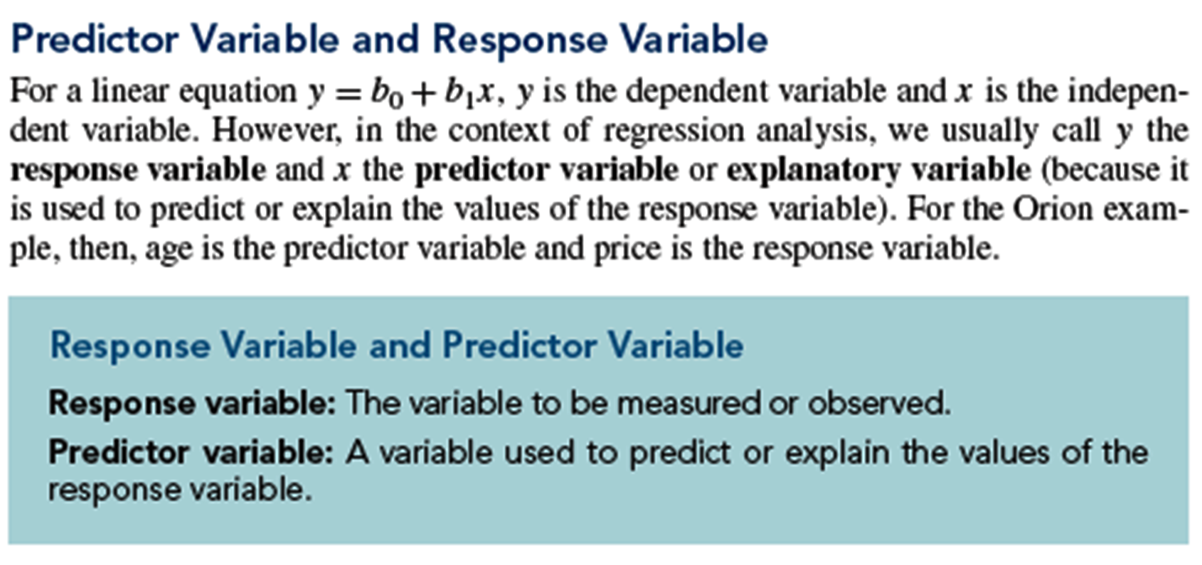

Slide 23
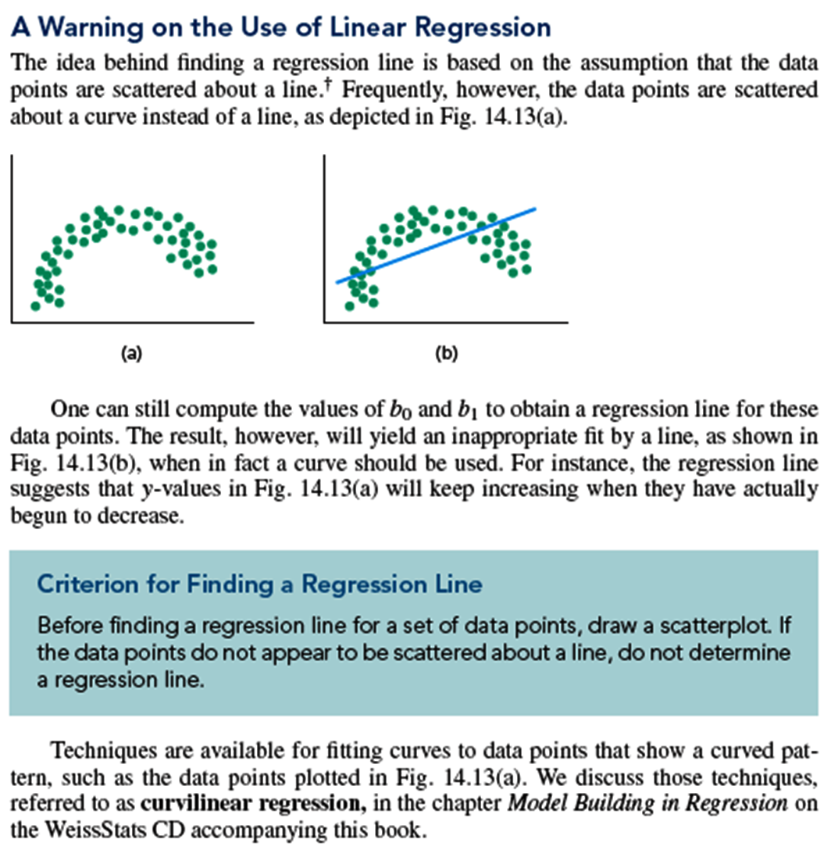

Slide 24
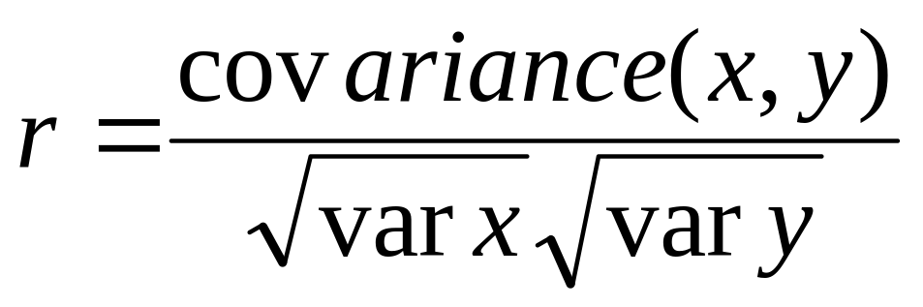
Correlation coefficient
Pearson’s Correlation Coefficient is standardized covariance (unitless):

Slide 25
Correlation
Measures the relative strength of the linear relationship between two variables
Unit-less
Ranges between –1 and 1
The closer to –1, the stronger the negative linear relationship
The closer to 1, the stronger the positive linear relationship
The closer to 0, the weaker any positive linear relationship

Slide 26
Scatter Plots of Data with Various Correlation Coefficients
Y
Y
Y
X
X
X
r = -1
r = -.6
r = 0
Y
Y
Y
X
X
X
r = +1
r = +.3
r = 0

Slide 27
Linear/non-linear Correlation
Linear relationships
Curvilinear relationships
Y
Y
X
X
Y
Y
X
X

Slide 28
Linear/non-linear Correlation
Strong relationships
Week relationships
Y
Y
X
X
Y
Y
X
X

Slide 29
Linear/non-linear Correlation
No relationship
Y
X
Y
X

Slide 30
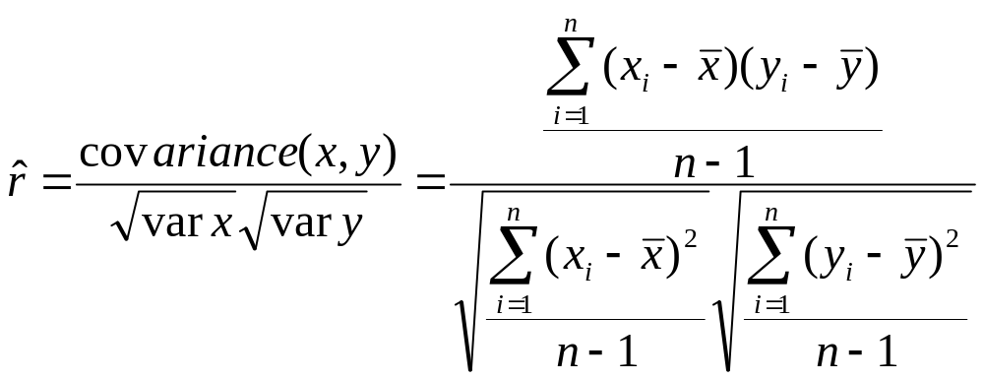
Calculating by hand…

Slide 31
The End

